Slide 1
Azure Devops DEEP DIVE Updated 20 October 2020

Slide 2
ADODD > Agenda
Pipelines
ADO
Repos
Boards
Big Picture
Artifacts

Slide 3
ADODD > Big Picture
Why do we need DevOps?

Slide 4
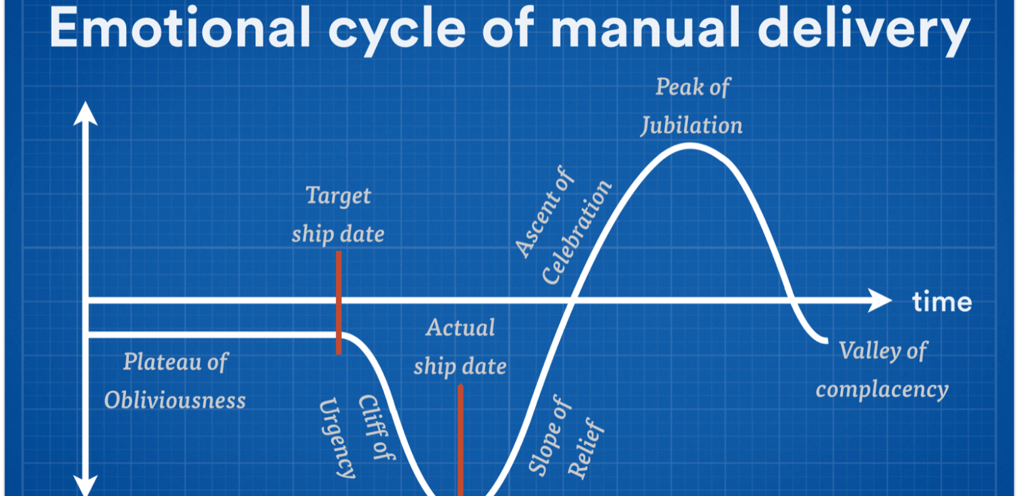
ADODD > Big Picture > Challenge
Notes:
How quickly you can fail fast or double down is determined by your cycle time. Your cycle time determines how quickly you can gather feedback to determine what happens in the next iteration. The feedback that you gather with each cycle should be real, actionable data. Manual delivery increases cycle times exponentially.

Slide 5
ADODD > Big Picture > Challenge
Repeated manual tasks are prone to errors and inconsistencies
Longer cycle times lead to lower ROI and wastes expensive IT resources
Centralized management introduces anomalies in decentralized environments
Cross-cutting concerns slows issue resolution
Manual delivery requires significant resource, carry greater risks and have long cycle times

Slide 6
ADODD > Big Picture
What is DevOps?

Slide 7
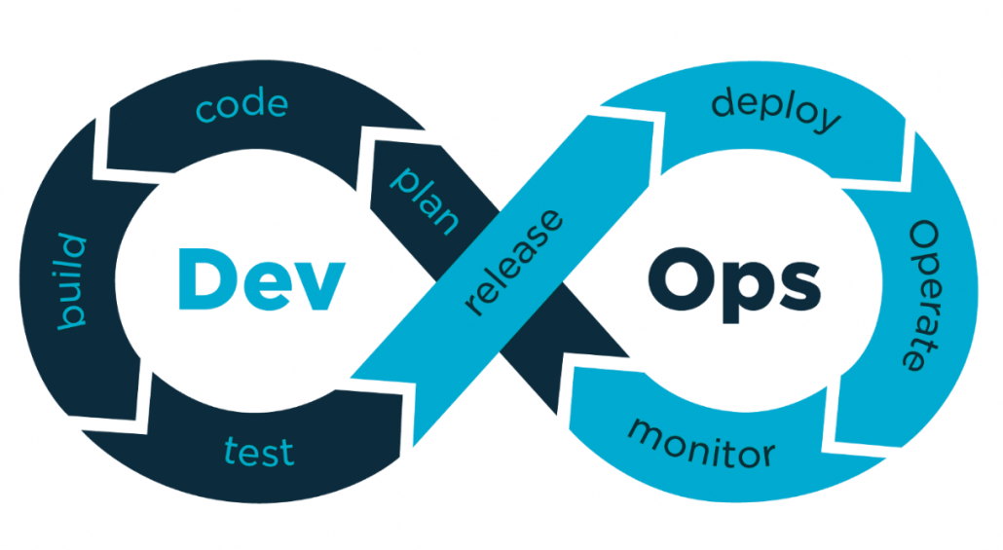
ADODD > Big Picture > DevOps

Slide 8
ADODD > Big Picture > DevOps > Traits
DevOps culture stresses small, multidisciplinary teams, who work autonomously and are collectively accountable
For a DevOps team, there’s no place like production. Everything they do is about making customers’ live experience better
DevOps teams work tirelessly to reduce cycle times and break down traditional barriers between Development and Operations
Essential DevOps practices include agile planning, continuous integration, continuous delivery, and monitoring of applications.

Slide 9
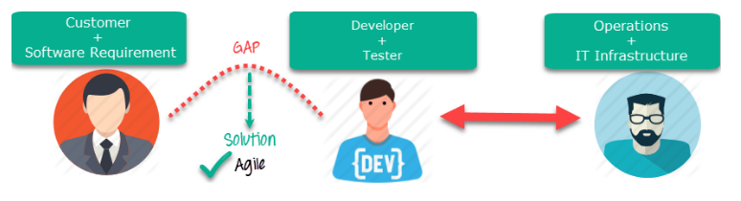
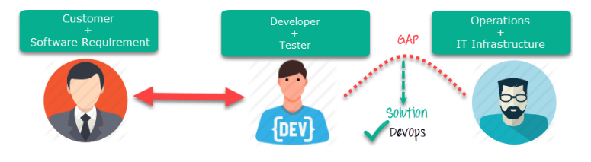
ADODD > Big Picture > DevOps > Process
Notes:
Agile => focuses on the gap between Business and IT.
DevOps => focuses on the gap between Development and Operations.

Slide 10
ADODD > Big Picture
What is Continuous Delivery?

Slide 11
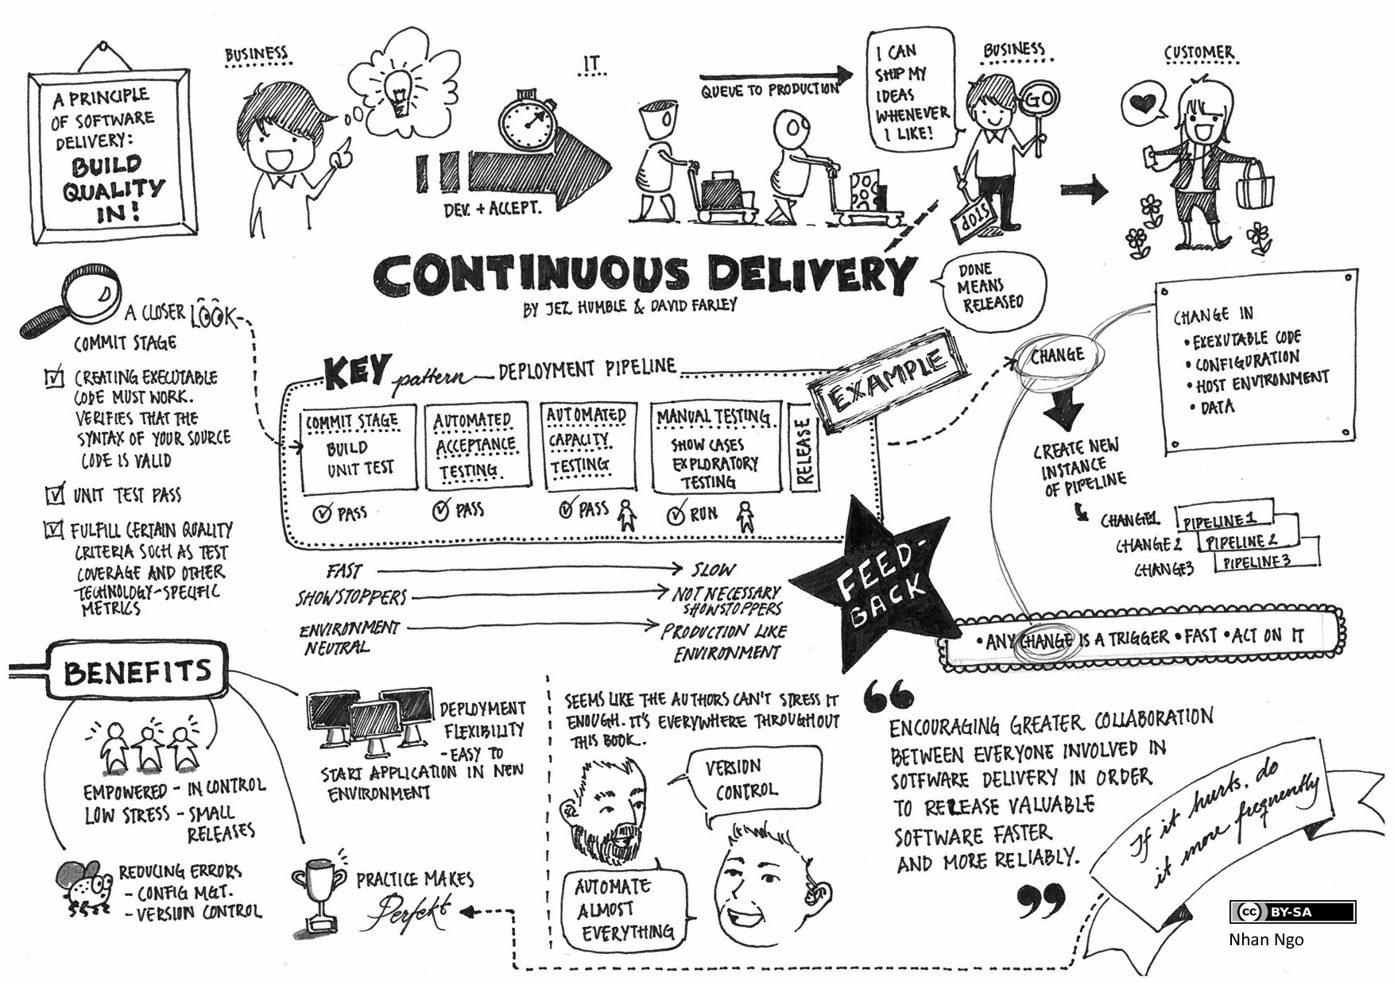
ADODD > Big Picture > Continuous Delivery
Notes:
Continuous Integration (CI) => is the process of automating the build and testing of code every time a team member commits changes to version control.
Continuous Delivery (CD) => is the process to build, test, configure and deploy from a build to a production environment.

Slide 12
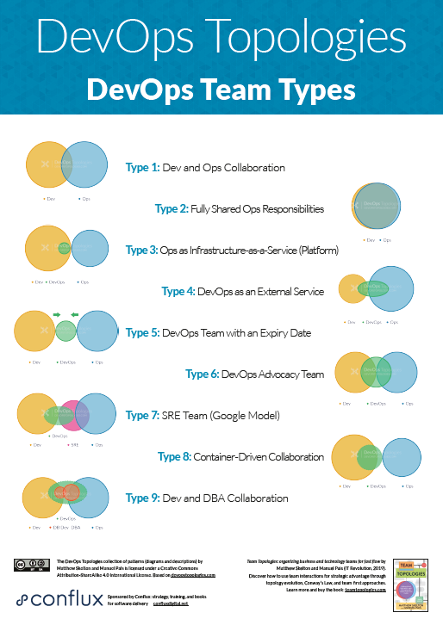
ADODD > Big Picture > Continuous Delivery > Best Practices
Build should pass in less than 5 min
Always commit small changes
Implement (and expand) Continuous Integration
Always have one stop between development and production
Deploy to every environment the same way
Automate everything

Slide 13
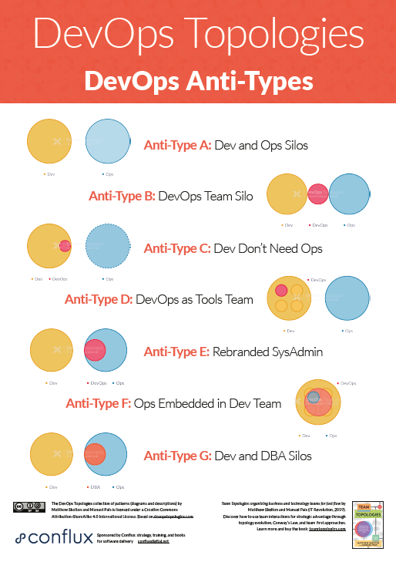
ADODD > Big Picture > Continuous Delivery > Common mistakes
Choosing the wrong team to do the job
Starting without a plan
Emphasizing process over quality
Getting rigid during implementation
Failing to break down Dev & Ops silos
Taking security for granted
Using to many new technologies

Slide 14

ADODD > Big Picture > Continuous Delivery > Demo

Slide 15


ADODD > Big Picture > Q/A

Slide 16
ADODD > ADO
What is Azure DevOps?

Slide 17
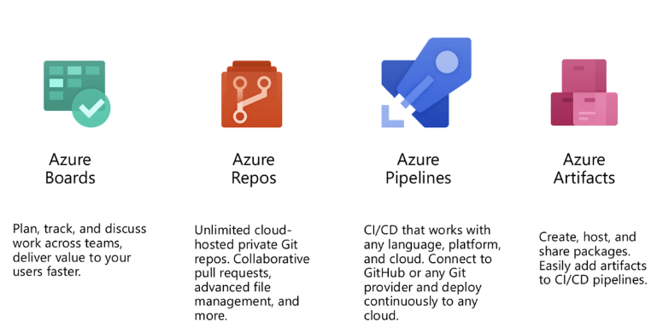
ADODD > ADO
Boards allow us to map business requirements to actionable work items
Artifacts allow us to bundle and share our work
Repos allow us to manage, share and version our work
Pipelines allow us to build and release our work

Slide 18
ADODD > ADO > Demo

Slide 19
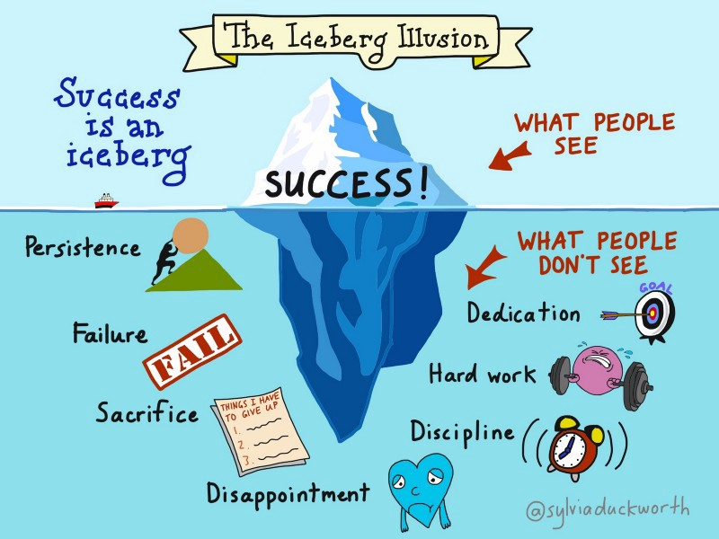
ADODD > ADO > Lab

Slide 20
ADODD > ADO > Lab
Navigate to github.com and sign-in with a valid user account
Create a new repository called ADODD-Demo
Navigate to dev.azure.com and sign-in with a valid user account
Create a new organization named: dev.azure.com/{my-unique-org-name}
Create a new project named: ADODD-Demo
Go to Project Settings > GitHub Connection and connect to a Git repository
Go to https://github.com/settings/tokens and generate a new personal access token (PAT)
Go to Project Settings > Service Connection and setup a new GitHub connection that uses our newly created PAT

Slide 21
ADODD > ADO > Q/A

Slide 22
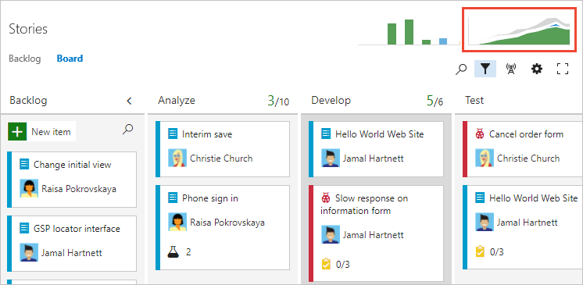
ADODD > ADO > Boards
Boards are ”process pipelines” for work items, which are the primary “unit of work” in projects
Boards reference backlogs to plan, prioritize and organize work items
Boards uses sprint backlogs to manage iterations and maintain agility
Boards uses queries to group work items across projects

Slide 23
ADODD > ADO > Boards > Lab

Slide 24
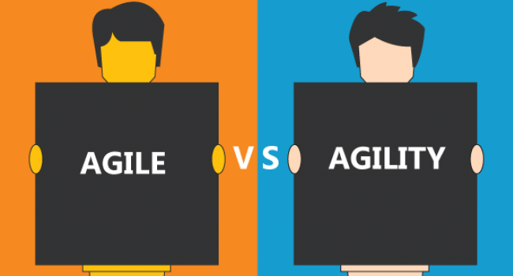
ADODD > ADO > Boards > Lab
Add “blocked” and “review” columns to the default board
Add “enablers” and “features” swinlanes to the default board
Create three work items in the default backlog
Setup three fixed-length sprints
Allocate one work item to each sprint
Configure a “work in progress” query to easily figure out what we are working on

Slide 25
ADODD > ADO > Boards > Q/A

Slide 26
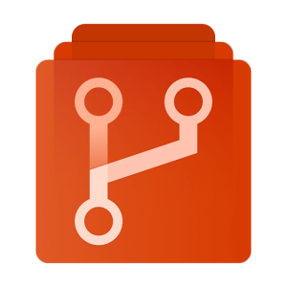
ADODD > ADO > Repos
Repos belong to projects
Repos use commits to track changes
Repos enables branching to support collaboration
Repos use Pull Requests to commit changes and update work items

Slide 27
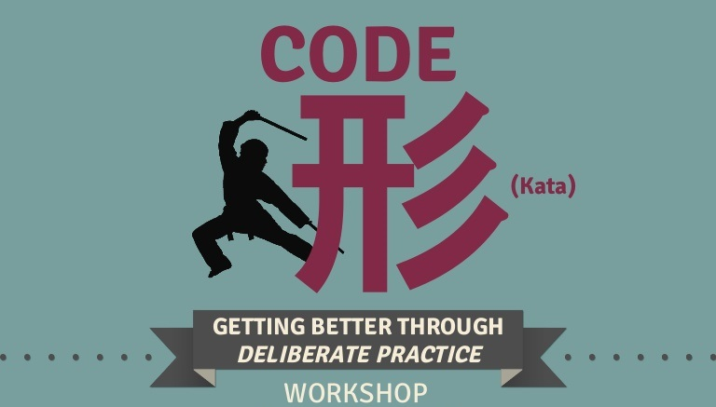
ADODD > ADO > Repos > Code Kata #1

Slide 28
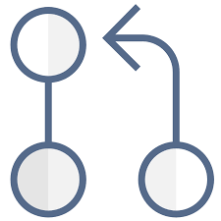
ADODD > ADO > Repos > Pull Requests
Pull requests combine the review and merge of commits into a single collaborative process
There's no commitment to merge the changes as the owner can abandon the pull request at any time
Pull Requests cross-pollinate expertise and spread problem solving strategies by using a wide range of reviewers
Pull Requests can be used to “bulk update” certain work item fields.

Slide 29
ADODD > ADO > Repos > Pull Requests > Lab

Slide 30
ADODD > ADO > Repos > Pull Requests > Lab
Create a new branch called “feature-x”
Edit the “README.MD”
Commit changes to “feature-x”
Create a new Pull Request from “feature-x” to “master”
Link pull request to existing work items
Add “Contributors” as a reviewer

Slide 31
ADODD > ADO > Repos > Q/A

Slide 32
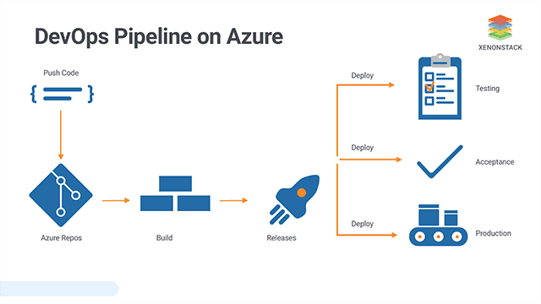
ADODD > ADO > Pipelines
Pipelines is used by projects to build and publish artifacts
Pipelines use environments to ”mimic” deployment targets
Pipelines use releases to deploy artifacts
Pipelines owns libraries of variables and files that can be referenced from anywhere in a project

Slide 33
ADODD > ADO > Pipelines > Lab

Slide 34
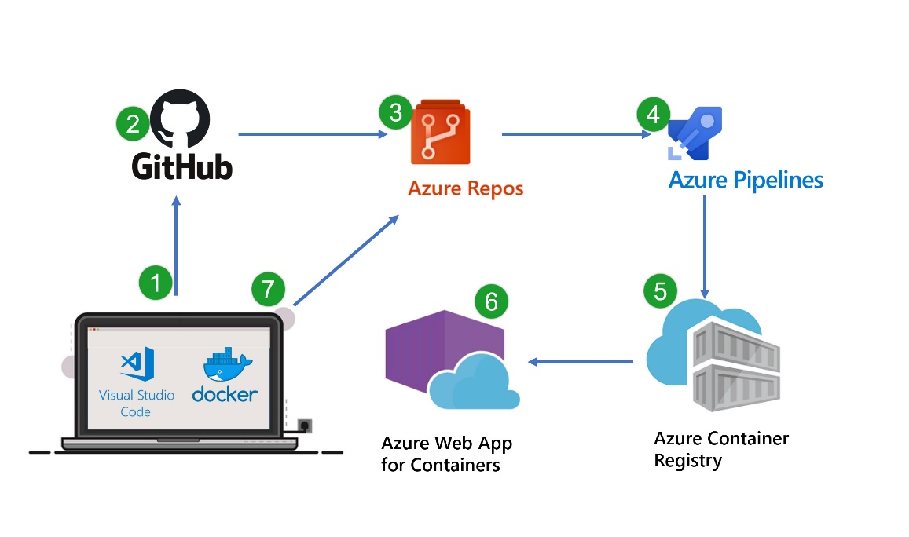
ADODD > ADO > Pipelines > Lab
Create a new pipeline named “My-Repo-Build”
Choose the “Azure Repos Git” option, select “my-repo” and use the “ASP.NET Core” template
Click “Save & Run” to verify that our new pipeline works as intended
Navigate to “my-repo” and verify that file named “azure-pipelines.yml” has been added to our master branch
Add a “pack” task that uses the .NET Core CLI to package our code
Notes:
task: DotNetCoreCLI@2
displayName: "Pack"
inputs:
command: 'pack'
packagesToPack: '**/*.csproj'
versioningScheme: 'off'

Slide 35
ADODD > ADO > Pipelines > Q/A

Slide 36
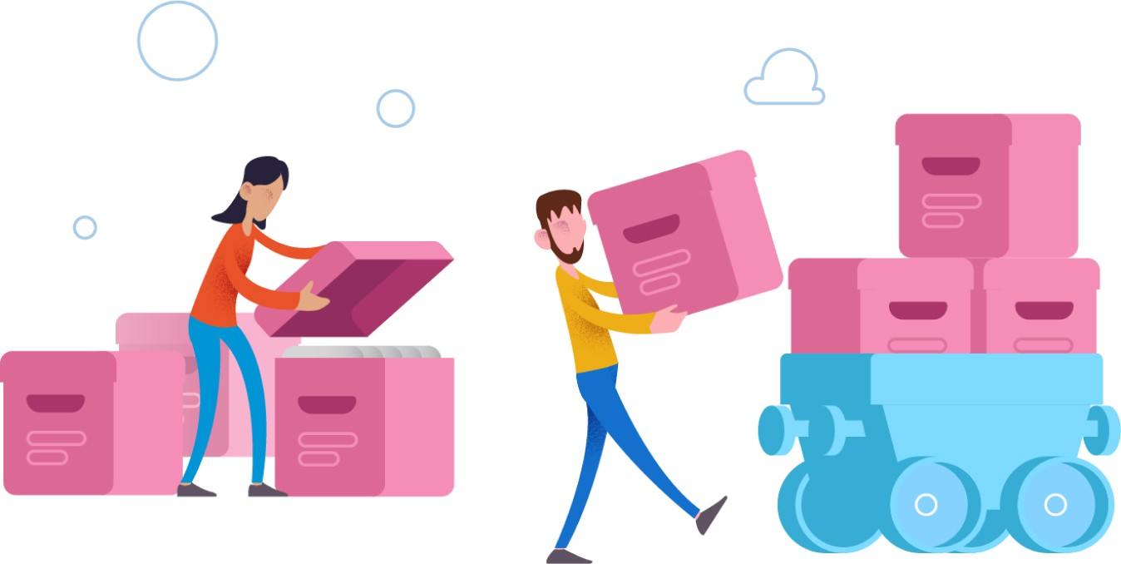
ADODD > ADO > Artifacts
With Azure Artifacts you can package and publish your application assets as versioned archives.
With Azure Artifacts you can create and share feeds from public and private package sources with teams of any size.

Slide 37
ADODD > ADO > Artifacts > Lab

Slide 38
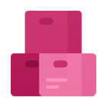
ADODD > ADO > Artifacts > Lab
Go to “Artifacts” and create a new feed called “my-nuget-feed”
Add a “publish” task that uses the .NET Core CLI to publish our code to the “my-nuget-feed” ID format for publishVstsFeed argument is ‘{project-name}/{feed-name}’
Re-run the “My-Repo-Build” pipeline
Notes:
task: DotNetCoreCLI@2
displayName: "Publish"
inputs:
command: 'push'
packagesToPush: '$(Build.ArtifactStagingDirectory)/*.nupkg'
nuGetFeedType: 'internal'
publishVstsFeed: '{project-name}/{feed-name}
'

Slide 39
ADODD > ADO > Artifacts > Q/A

Slide 40
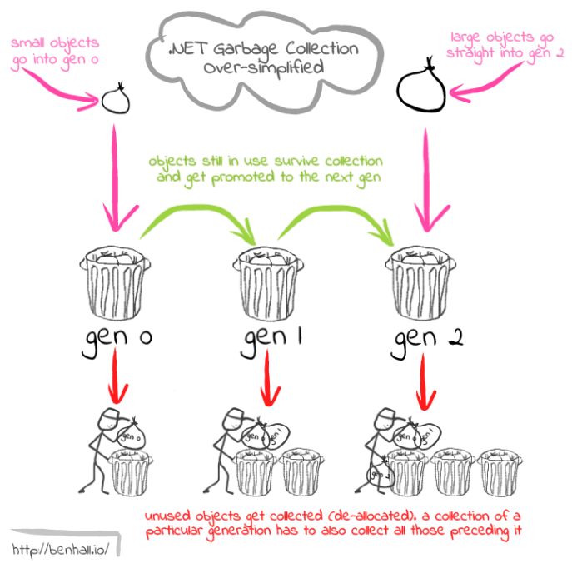
ADODD > ADO > Garbage Collection
Go to https://github.com/{username}/ADODD-Demo/settings and delete the repository.
Go to https://github.com/settings/tokens and delete the token we created for our service connection.
Go to dev.azure.com/{my-unique-org-name}/_settings/organizationOverview and delete the ADO organization.

Slide 41
ADODD > Feedback
https://forms.office.com/Pages/ResponsePage.aspx?id=ZpSpcwWtIUKfkOcUKqL2wTFclz-gNvpNq3THAj1j3ZxUODk1TjlEWVNJNzUxNjAwTFhGQkQ2VkNTWi4u

Slide 42
ADODD > Literature
https://docs.microsoft.com/en-us/azure/devops/?view=azure-devops
https://docs.microsoft.com/en-us/azure/devops/learn/what-is-devops
https://www.codeproject.com/Articles/1394594/Devops-The-Big-Picture
https://www.sumologic.com/insight/continuous-delivery-best-practices/
https://hackernoon.com/the-last-mile-to-true-continuous-delivery-6sk323j
https://devops.com/common-mistakes-developers-commit-when-integrating-devops/

